Slide 1

PC SALES AND SERVICE
By
Name – Aditya Ranjan Mishra (BS17CSC017)
Sanjit Panigrahi (BS17CSC030)
DEPARTMENT OF COMPUTER SCIENCE
Under the Supervision of
Mr. Samit Kumar Pradhan(H.O.D)
GANGADHAR MEHER UNIVERSITY,AMRUTA VIHAR, SAMBALPUR

Slide 2
CONTENT
Aim
Scope
Use Case Diagram
System Features Table

Slide 3
AIM
Aim of PC Sales and Service system is to bring the PC services and repairing work to a online form.
It helps to create a interactive platform to increase the services quality with the facility of service at doorstep.
This help to reduce the time of transportation and the lack of interaction between consumer and service provider.

Slide 4
SCOPE
The main focus is to provide computer services in a less time consuming way with a better interaction between the consumer and service provider.
It also helps local businessman to expand their services in an effective manner.

Slide 5
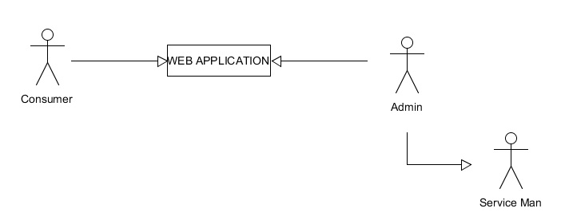
Actors

Slide 6
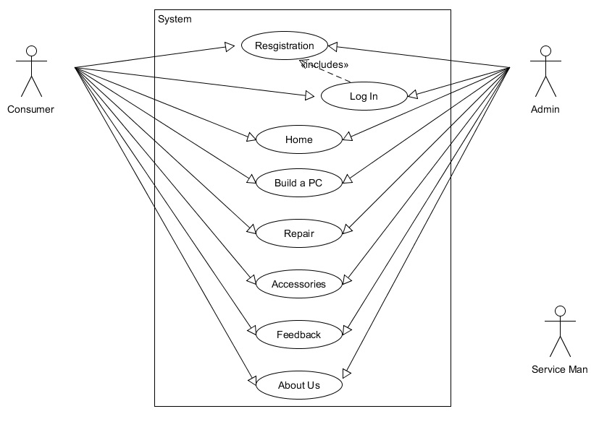
Use Case Diagram

Slide 7
System Features List
Admin Registration and Log in
Customer Registration and Log in
View Homepage
Request for a PC(Build a PC)
Request for Repair service
Request for Accessories
Give Feedback
View About Us

Slide 8
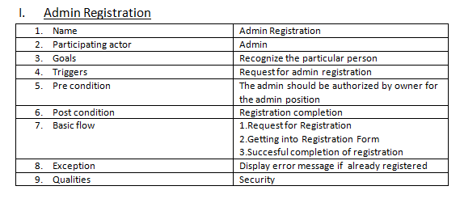
System Features

Slide 9
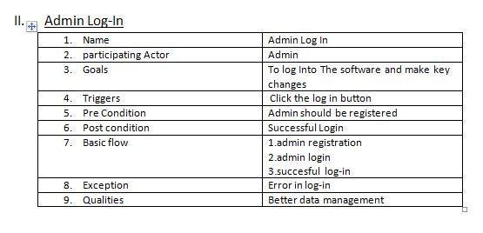

Slide 10
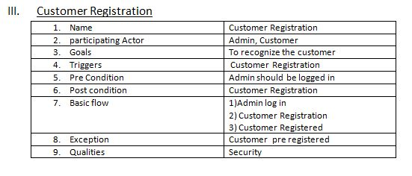

Slide 11
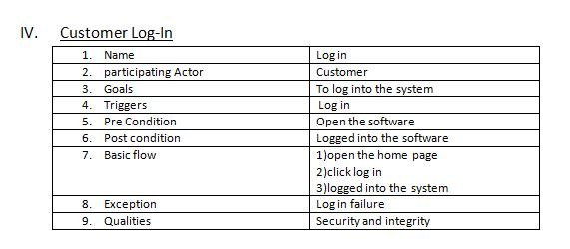

Slide 12
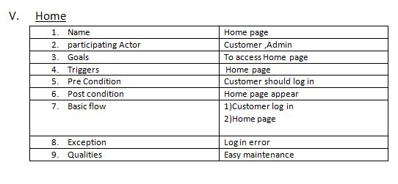

Slide 13
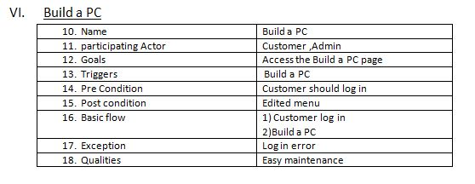

Slide 14
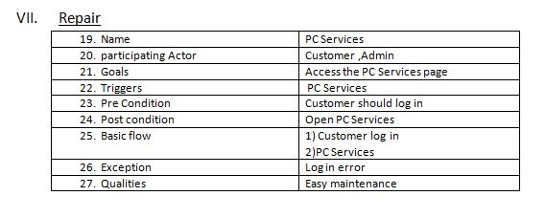

Slide 15
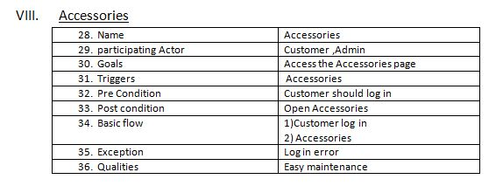

Slide 16
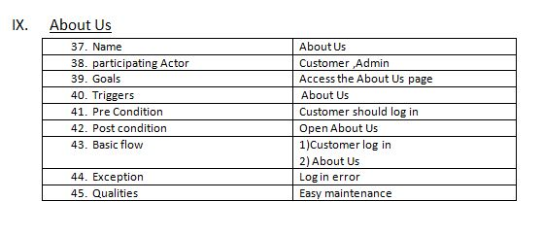

Slide 17
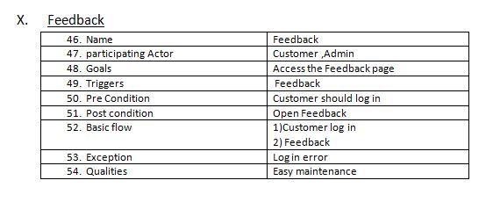

Slide 18
THANK YOU

